Slide 1
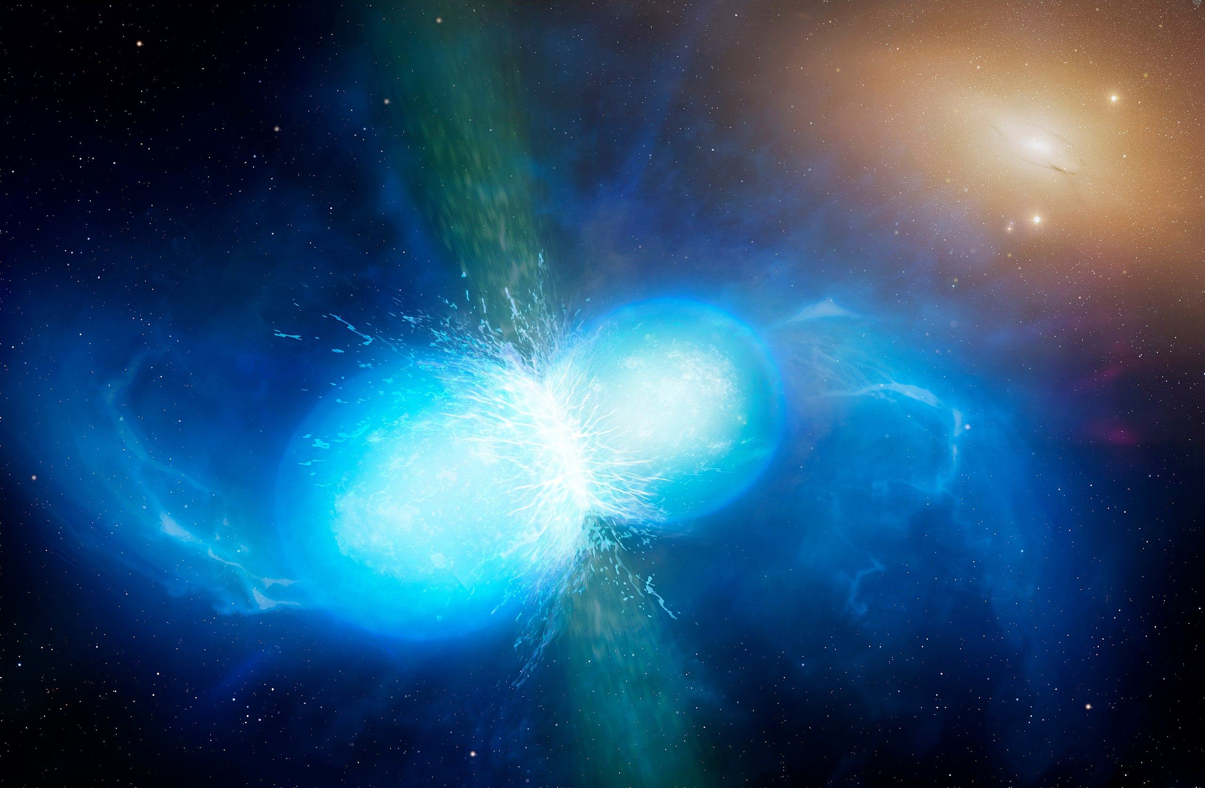
Finding NEMO: Optimising a neutron star extreme matter observatory
Justin Yu (juyu0917@uni.sydney.edu.au)
Supervisor: Bram Slagmolen, Lilli Sun
University of Warwick/Mark Garlick, CC BY 4.0 <https://creativecommons.org/licenses/by/4.0>, via Wikimedia Commons

Slide 2
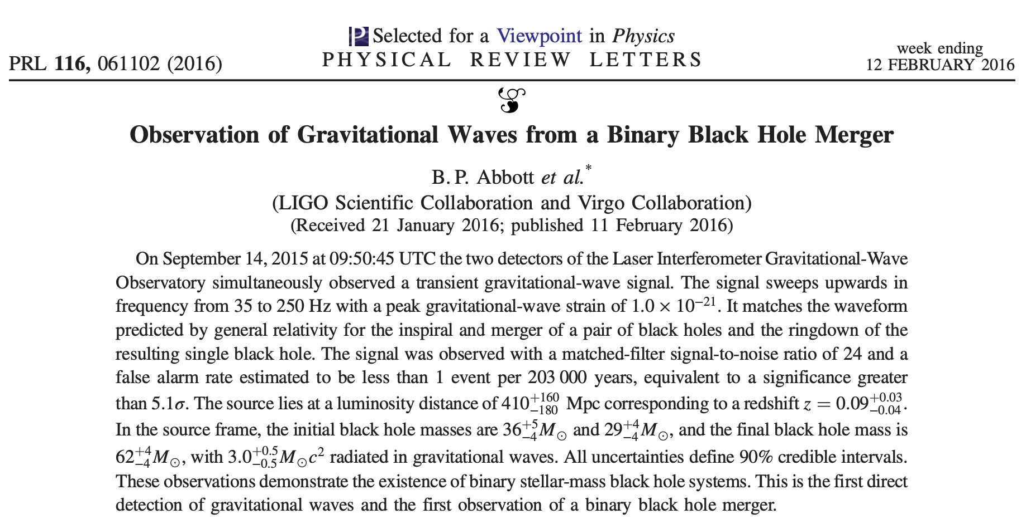
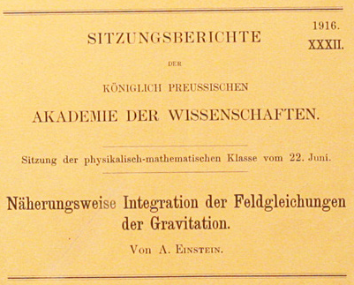
Background

Slide 3
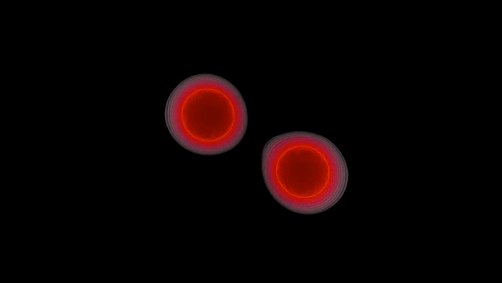
Neutron Star Extreme Matter Observatory (NEMO)
Binary neutron star post-merger oscillations
Depend on unknown equation of state (EoS)
Extreme nuclear physics! e.g. hadron-quark phase transition
Multi-messenger astronomy
Current detectors not sensitive in kHz
NEMO concept sensitive in 1-4kHz band
https://www.youtube.com/watch?v=Dyn9KbB_zeo

Slide 4
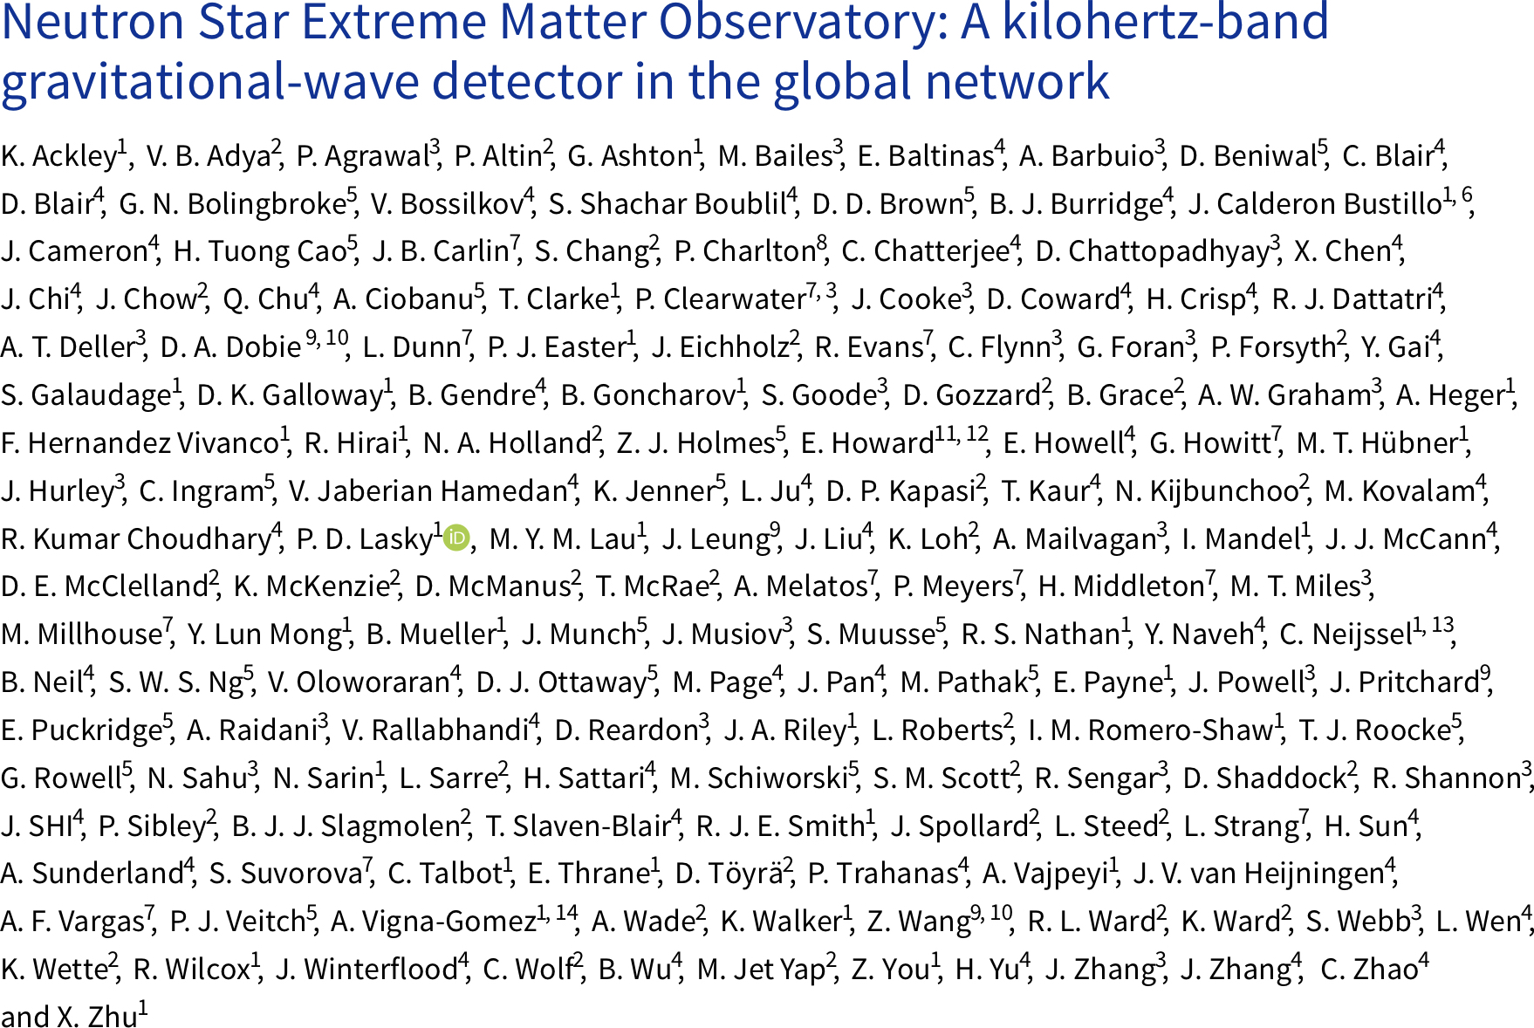
Neutron Star Extreme Matter Observatory (NEMO)
Binary neutron star post-merger oscillations
Depend on unknown equation of state (EoS)
Extreme nuclear physics! e.g. hadron-quark phase transition
Multi-messenger astronomy
Current detectors not sensitive in kHz
NEMO concept sensitive in 1-4kHz band

Slide 5
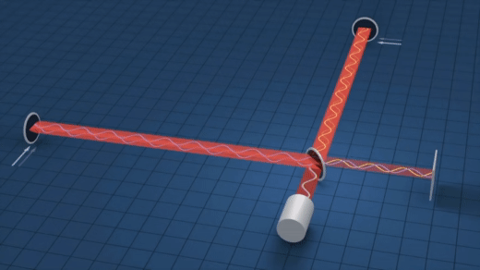
Detecting gravitational waves
Basic idea
Michelson interferometer experiences differential arm length change
Optical path length difference creates interference
Signal “sidebands” in frequency domain
https://www.youtube.com/watch?v=UA1qG7Fjc2A

Slide 6
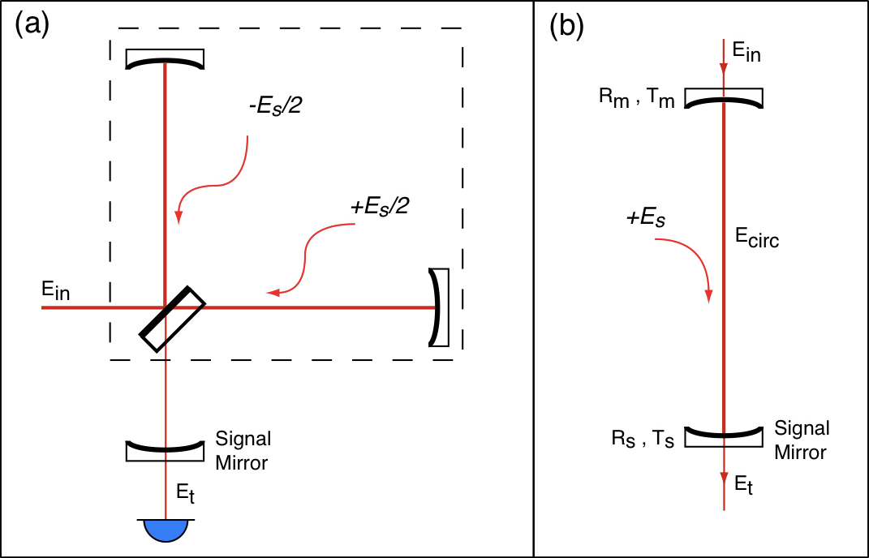
Detecting gravitational waves
Signal recycling
Add mirror (SRM) in front of output port to form signal recycling cavity
Signal sidebands resonantly enhanced
Tuning (microscopic displacement offset) and transmittivity change resonance
Figure 2.2 from de Vine, G – Variable Reflectivity Mirrors for Signal Recycled Michelson Interferometer Gravitational Wave Detectors (2001) (Honours thesis)

Slide 7
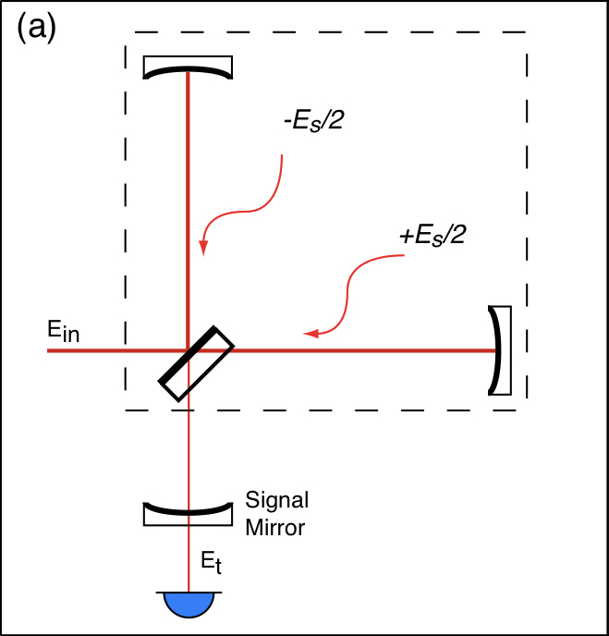
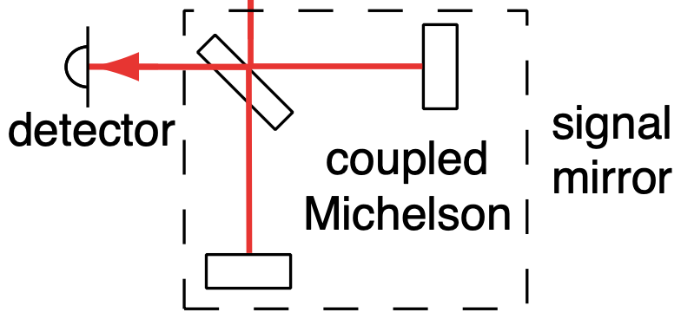
Detecting gravitational waves
Variable reflectivity mirror
Another Michelson can act as a variable-reflectivity mirror (vSRM)
Tunable sensitivity!
Adapted from Figure 2.9 from de Vine, G – Variable Reflectivity Mirrors for Signal Recycled Michelson Interferometer Gravitational Wave Detectors (2001) (Honours thesis)

Slide 8
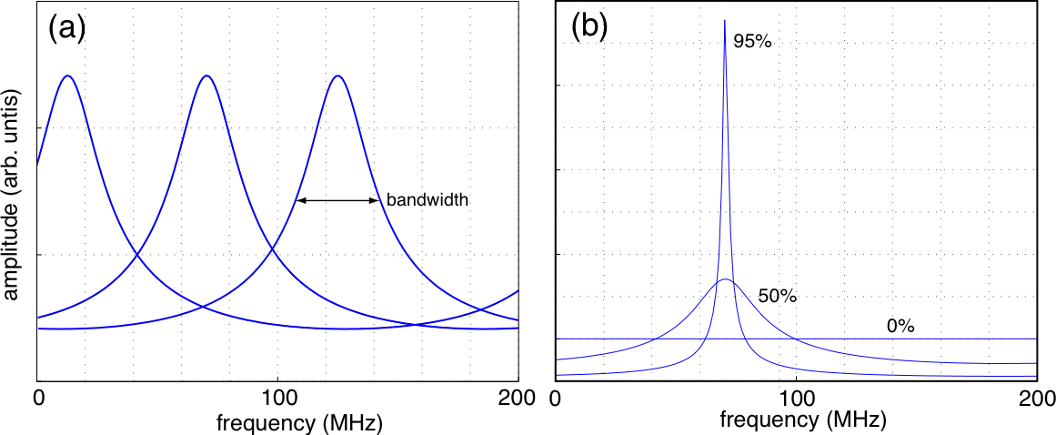
Detecting gravitational waves
More on the vSRM
Change SRC tuning
Change SRM reflectivity
de Vine showed orthogonality:
SRC tuning → peak frequency
SRM reflectivity → peak bandwidth
Orthogonality disappears when arm cavities are added (three-mirror coupled cavity)
vSRM provides flexibility
Adapted from Figure 2.4 from de Vine, G – Variable Reflectivity Mirrors for Signal Recycled Michelson Interferometer Gravitational Wave Detectors (2001) (Honours thesis)

Slide 9
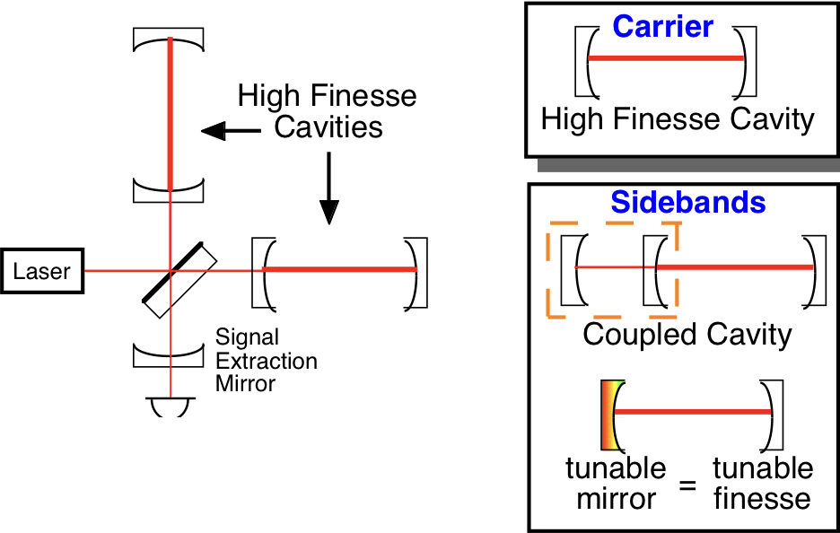
Detecting gravitational waves
More on the vSRM
de Vine showed orthogonality:
SRC tuning → peak frequency
SRM reflectivity → peak bandwidth
Orthogonality disappears when arm cavities are added (three-mirror coupled cavity)
vSRM provides flexibility
Adapted from Figure 4 from McClelland, D & Gray, M – Advanced interferometer configurations (2003)

Slide 10
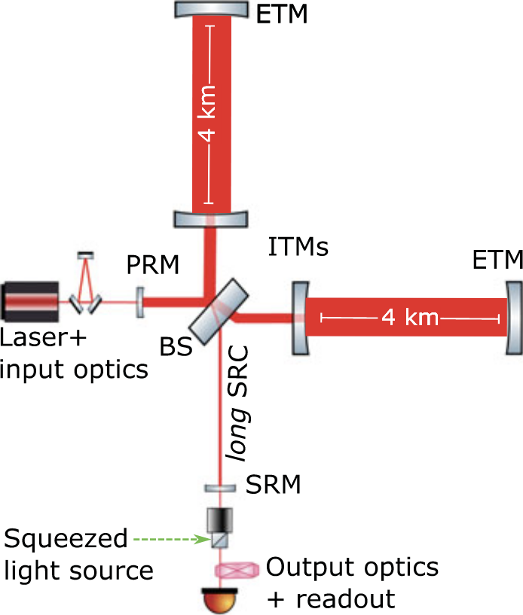
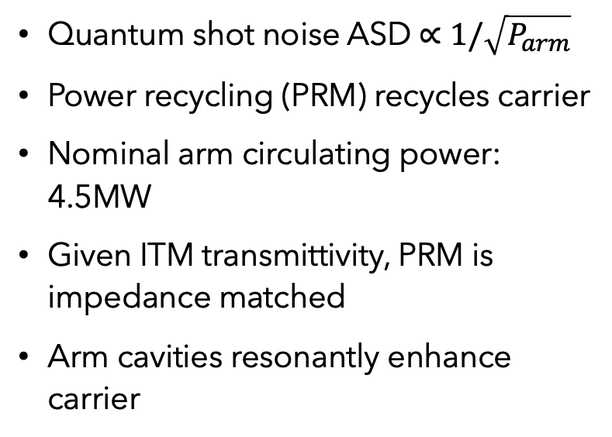
Detecting gravitational waves
Advancing the detector layout
Quantum shot noise ASD $∝1/\sqrt{P_{arm}}$
Power recycling (PRM) recycles carrier
Nominal arm circulating power: 4.5MW
Given ITM transmittivity, PRM is impedance matched
Arm cavities resonantly enhance carrier
Figure 2.2 from de Vine, G – Variable Reflectivity Mirrors for Signal Recycled Michelson Interferometer Gravitational Wave Detectors (2001) (Honours thesis)

Slide 11
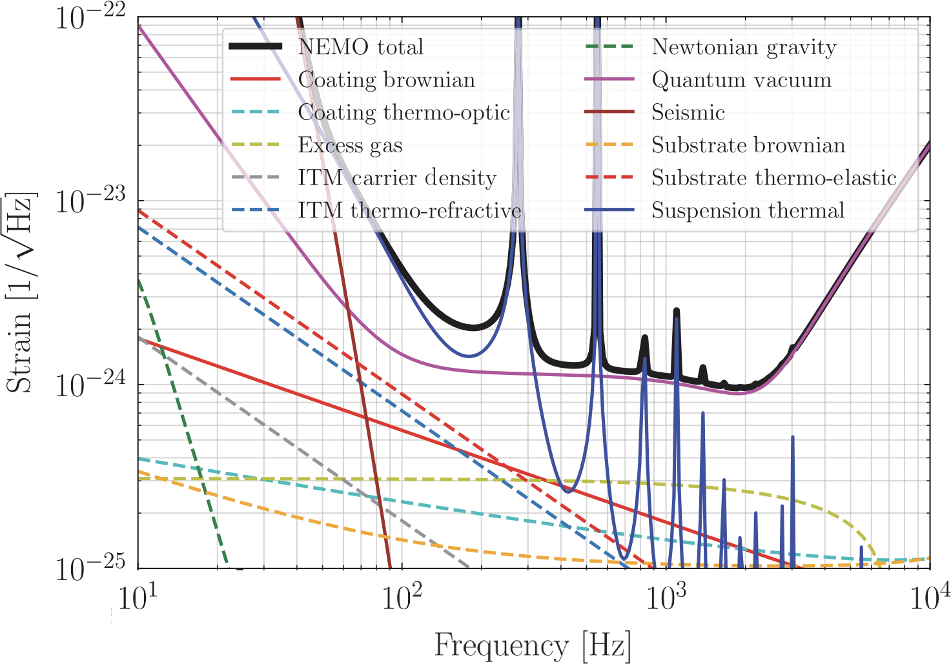
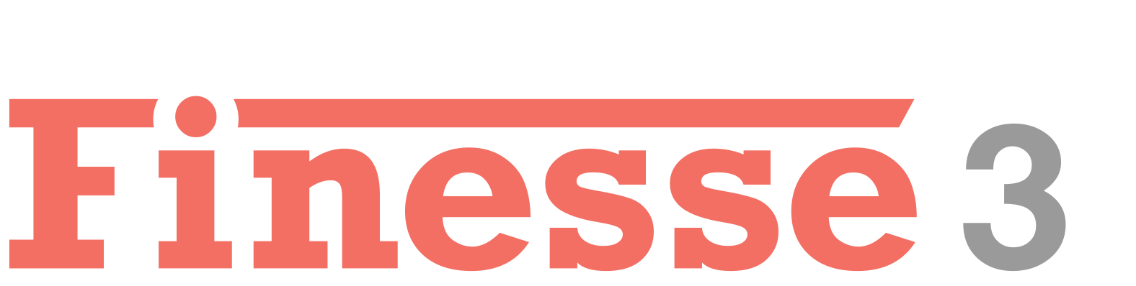
Optimising NEMO
Model detector configurations
Inject NR waveforms
Calculate detection rate
Aim Maximise BNS post-merger signal detection rate
Sensitivity
Finesse calculates quantum noise using two-photon formalism (Caves & Schumaker)
Quantum noise limited in kHz
Shot noise and radiation pressure components
Squeezing improves sensitivity (7dB)
Units: amplitude spectral density (1/√Hz)
ASD
Brown, DD & Freise, A 2014 Finesse
Adapted from Figure 1 from Ackley, K et al. – Neutron Star Extreme Matter Observatory: A kilohertz-band gravitational-wave detector in the global network (2020)

Slide 12
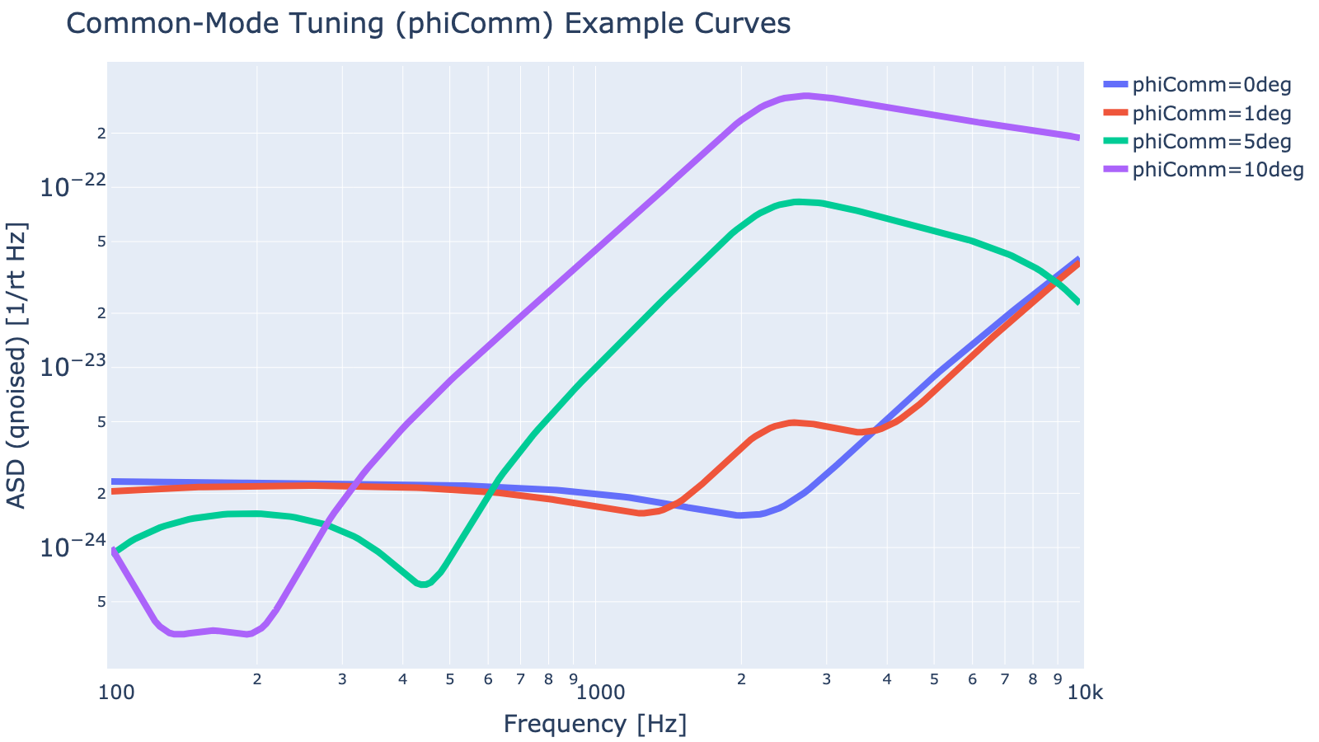
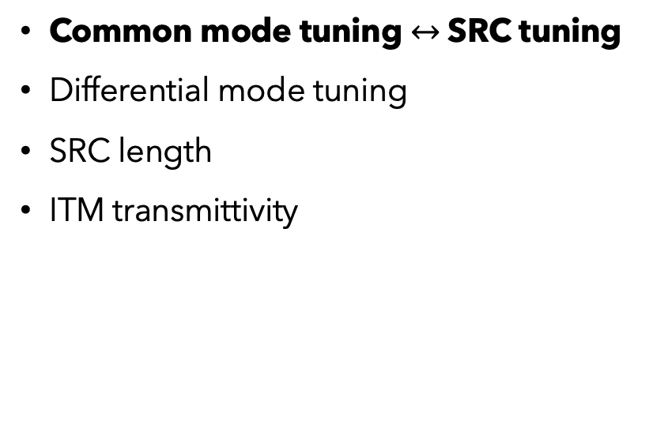
Optimising NEMO
Model detector configurations
Inject NR waveforms
Calculate detection rate
Aim Maximise BNS post-merger signal detection rate
Parameters
Common mode tuning $↔$ SRC tuning
Differential mode tuning
SRC length
ITM transmittivity

Slide 13
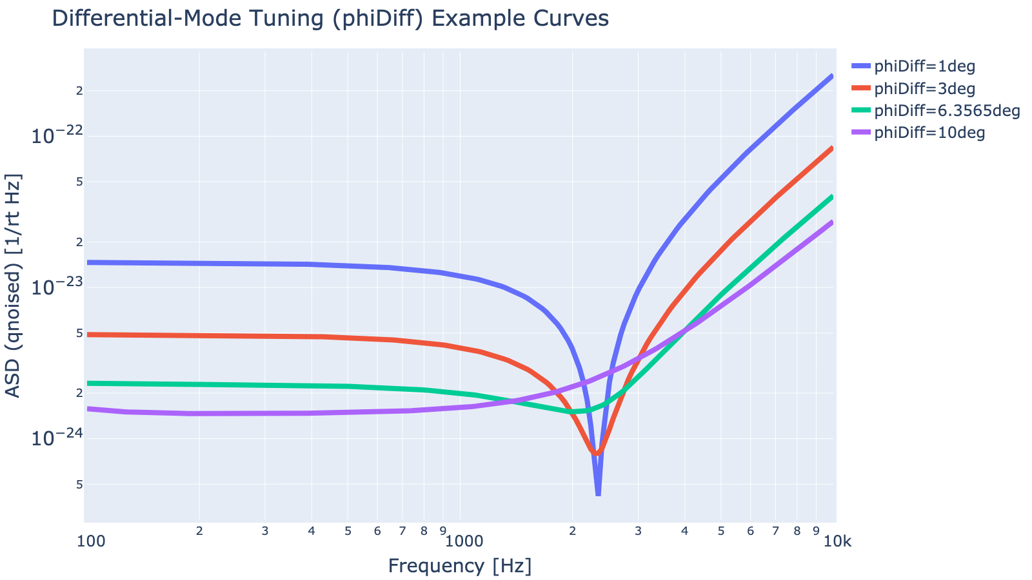
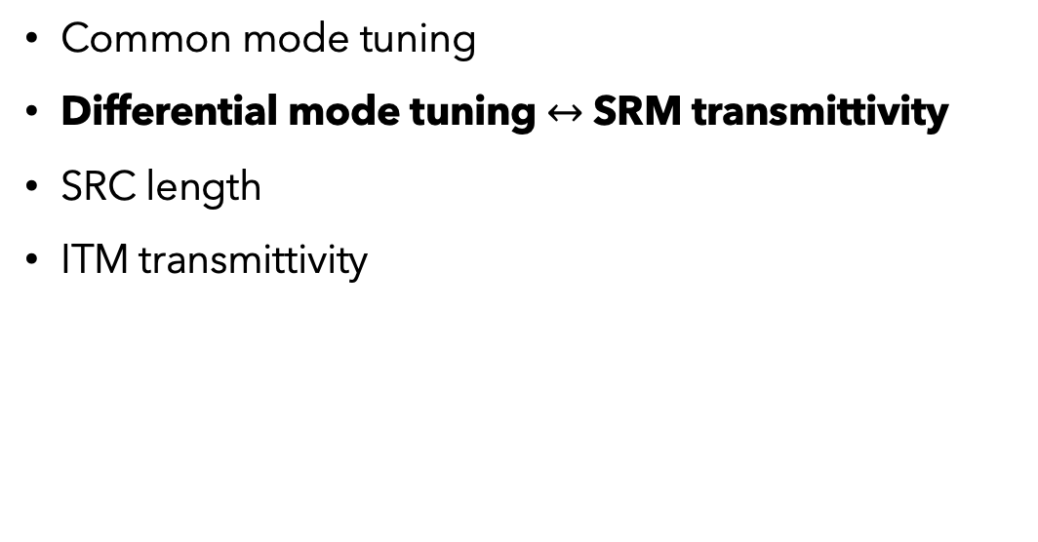
Optimising NEMO
Model detector configurations
Inject NR waveforms
Calculate detection rate
Aim Maximise BNS post-merger signal detection rate
Parameters
Common mode tuning
Differential mode tuning $↔$ SRM transmittivity
SRC length
ITM transmittivity

Slide 14
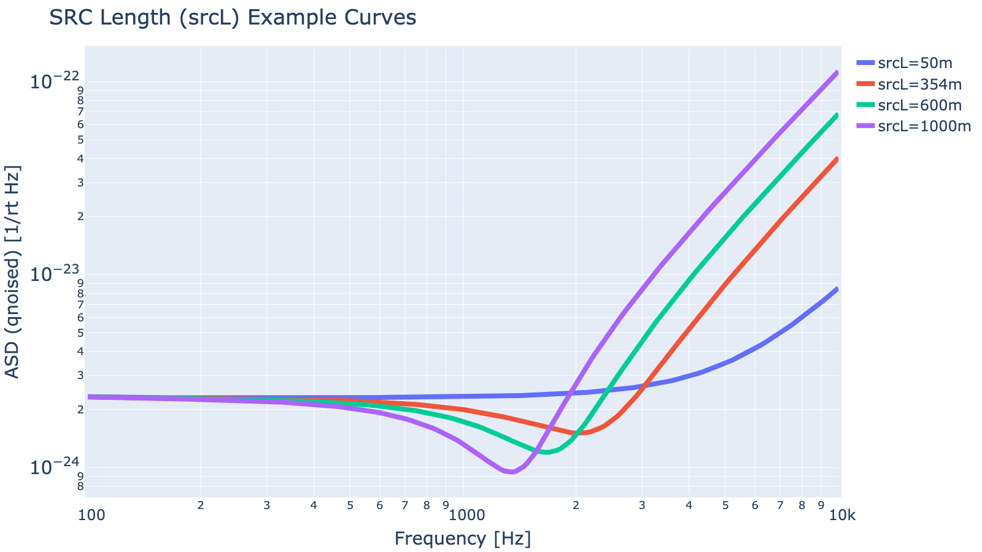
Optimising NEMO
Model detector configurations
Inject NR waveforms
Calculate detection rate
Aim Maximise BNS post-merger signal detection rate
Parameters
Common mode tuning
Differential mode tuning
SRC length
ITM transmittivity

Slide 15
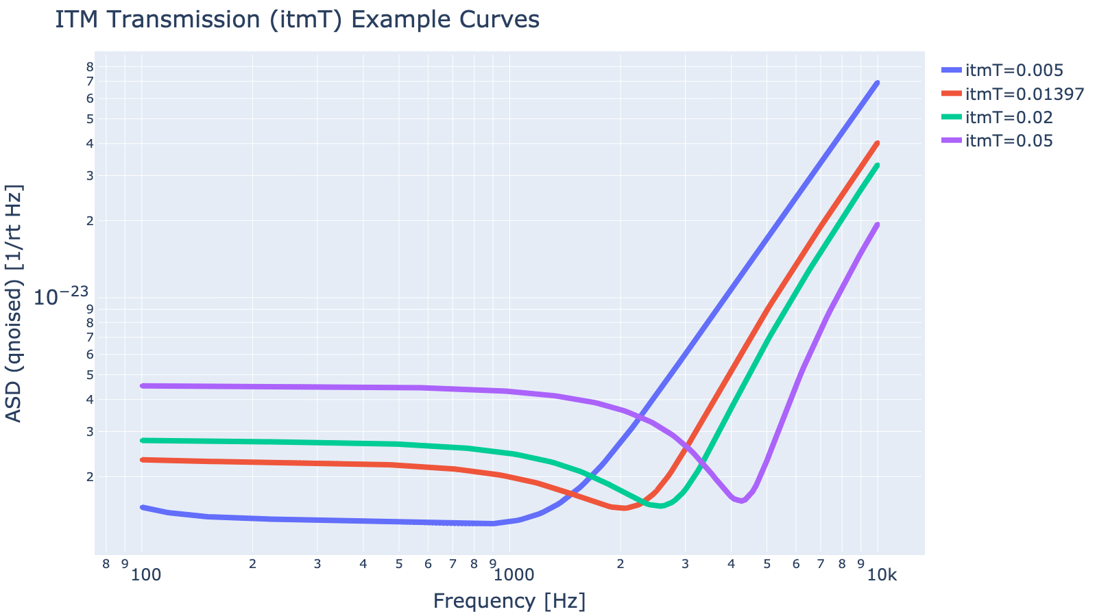
Optimising NEMO
Model detector configurations
Inject NR waveforms
Calculate detection rate
Aim Maximise BNS post-merger signal detection rate
Parameters
Common mode tuning
Differential mode tuning
SRC length
ITM transmittivity

Slide 16
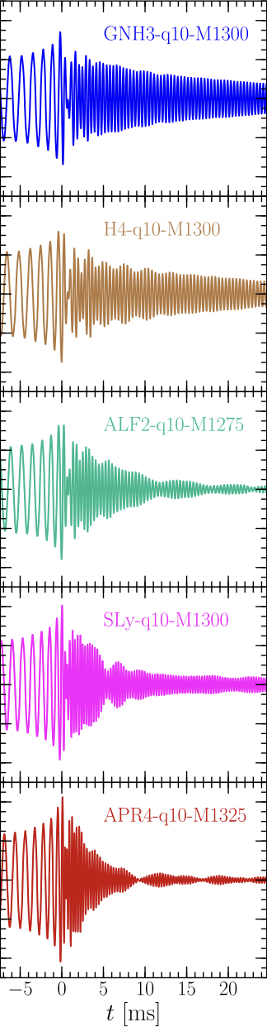
Optimising NEMO
Model detector configurations
Inject NR waveforms
Calculate detection rate
Aim Maximise BNS post-merger signal detection rate
Astrophysical assumptions
Merger rate: 105.5 Gpc⁻³.yr⁻¹
Galactic BNS mass distribution
Detector horizon: 400 Mpc (c.f. LIGO 100-200 Mpc)
>200 NR waveforms
18 EoS candidates
Thanks to previous student contributions: Mallika Sinha, Lewis Miller Abbott, BP et al. , ‘Population of merging compact binaries inferred using gravitational waves through GWTC-3’, Physical Review X (accepted December 2022)
Adapted from Figure 6 from Takami et al. – Spectral properties of the post-merger gravitational-wave signal from binary neutron stars (2015)

Slide 17
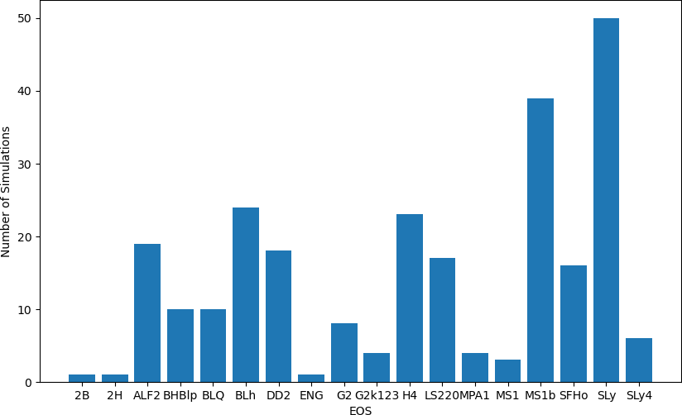
Optimising NEMO
Model detector configurations
Inject NR waveforms
Calculate detection rate
Aim Maximise BNS post-merger signal detection rate
Astrophysical assumptions
Merger rate: 105.5 Gpc⁻³.yr⁻¹
Galactic BNS mass distribution
Detector horizon: 400 Mpc (c.f. LIGO 100-200 Mpc)
>200 NR waveforms
18 EoS candidates
Thanks to previous student contributions: Mallika Sinha, Lewis Miller Abbott, BP et al. , ‘Population of merging compact binaries inferred using gravitational waves through GWTC-3’, Physical Review X (accepted December 2022)

Slide 18
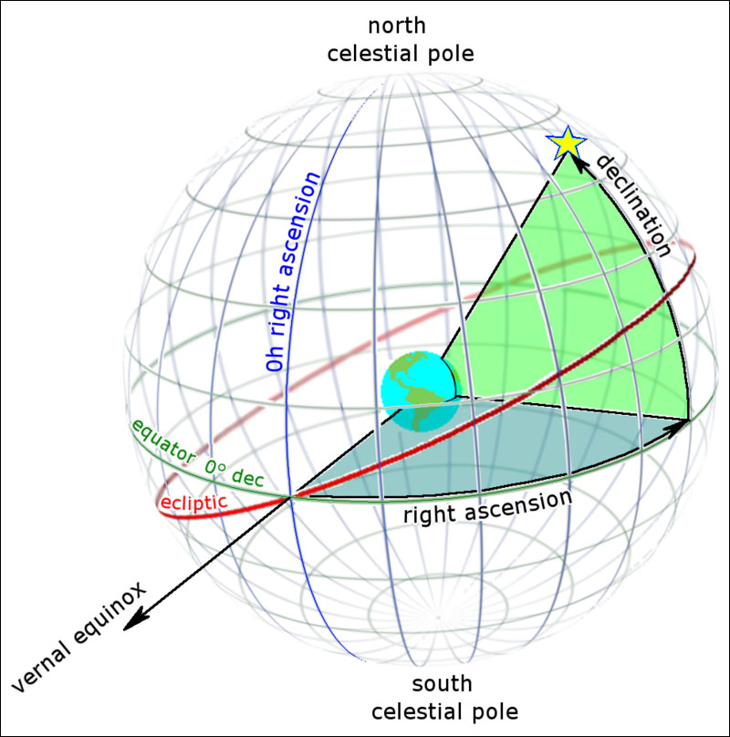
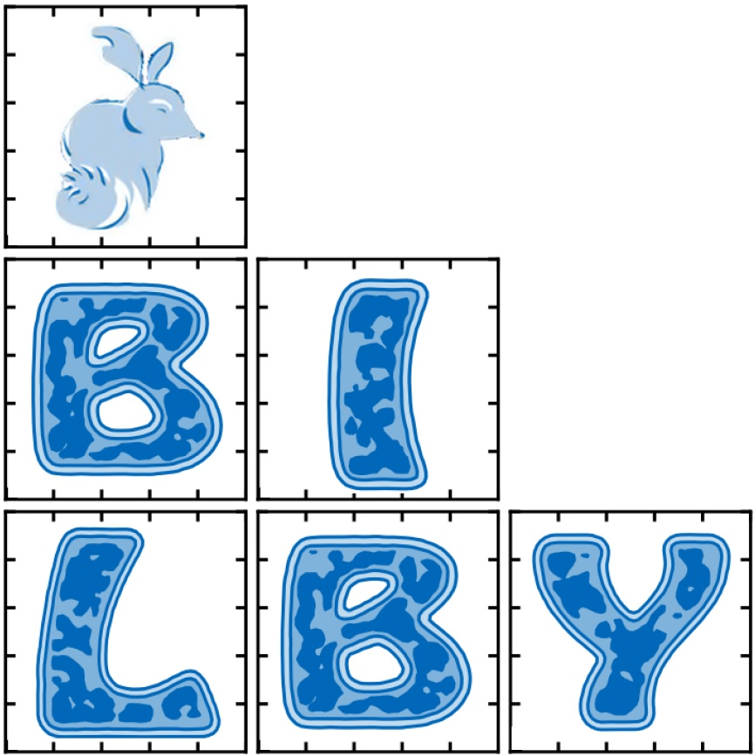
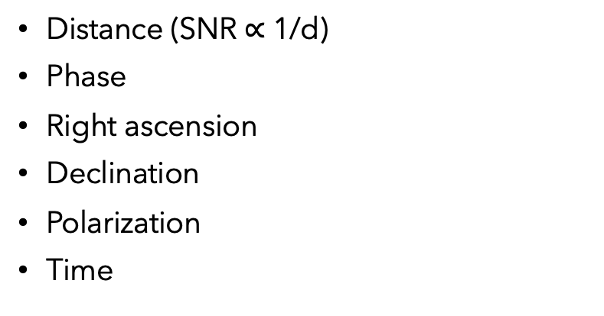
Optimising NEMO
Model detector configurations
Inject NR waveforms
Calculate detection rate
Aim Maximise BNS post-merger signal detection rate
Injection parameters
Distance (SNR $∝$ 1/d)
Phase
Right ascension
Declination
Polarization
Time
Ashton G, et al. 2019 ‘BILBY: A User-friendly Bayesian Inference Library for Gravitational-wave Astronomy’ , The Astrophysical Journal Supplement Series, vol. 241 no. 2.
https://skyandtelescope.org/wp-content/uploads/RA-Dec-wiki-Tom-RuenCC-BY-SA-3.0.jpg

Slide 19
Optimising NEMO
Model detector configurations
Inject NR waveforms
Calculate detection rate
Aim Maximise BNS post-merger signal detection rate
NEMO+
NEMO (2020)
Common mode tuning: 0 deg
Differential mode tuning: 2.7976 deg*
SRC length: 600m
ITM transmittivity: 3.7%
Peak sensitivity: 3.71e-25
7dB squeezing
Common mode tuning: 0 deg
Differential mode tuning: 6.3565 deg
SRC length: 354m
ITM transmittivity: 1.4%
Peak sensitivity: 9.93e-25
10dB squeezing (7dB in paper)

Slide 20
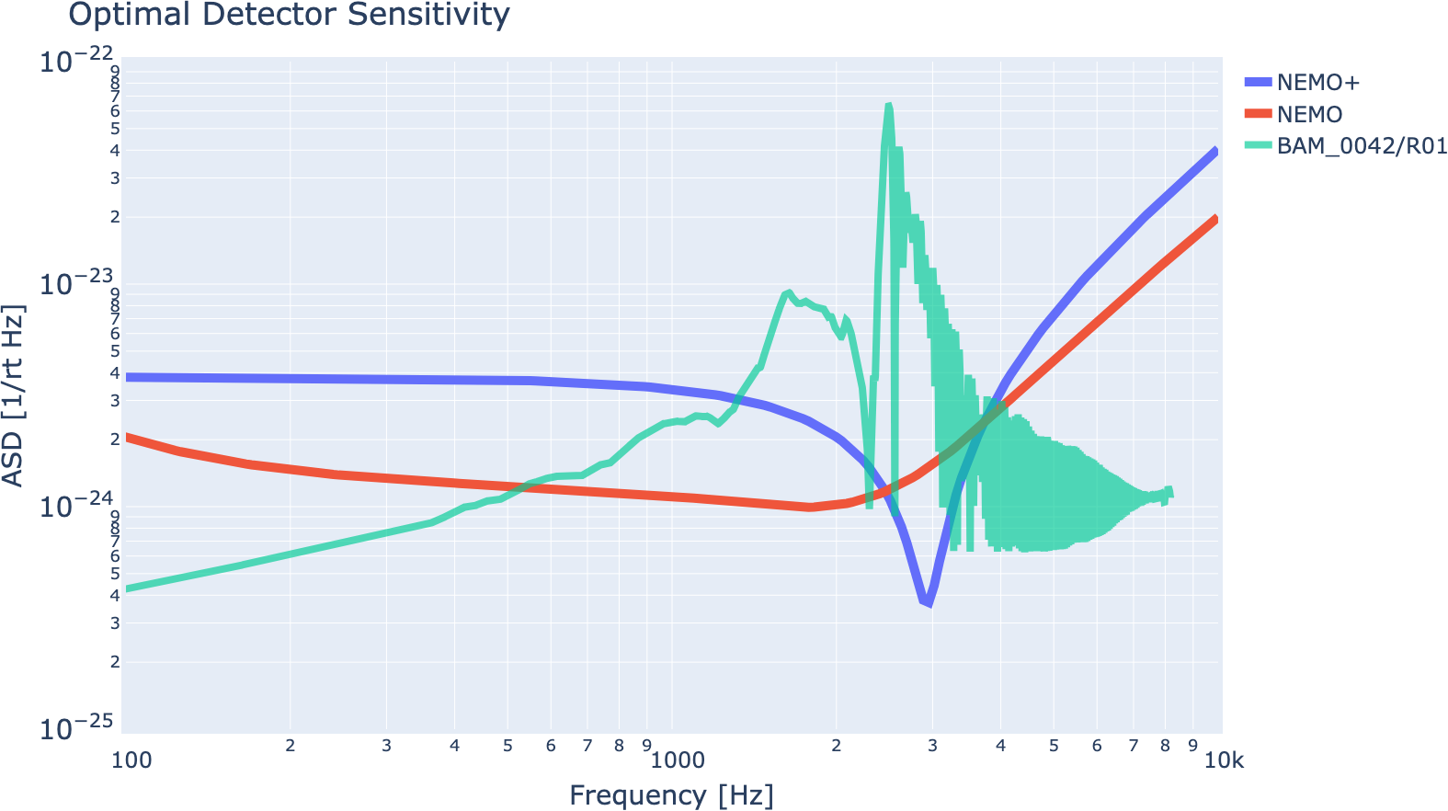
Optimising NEMO
Model detector configurations
Inject NR waveforms
Calculate detection rate
Aim Maximise BNS post-merger signal detection rate

Slide 21
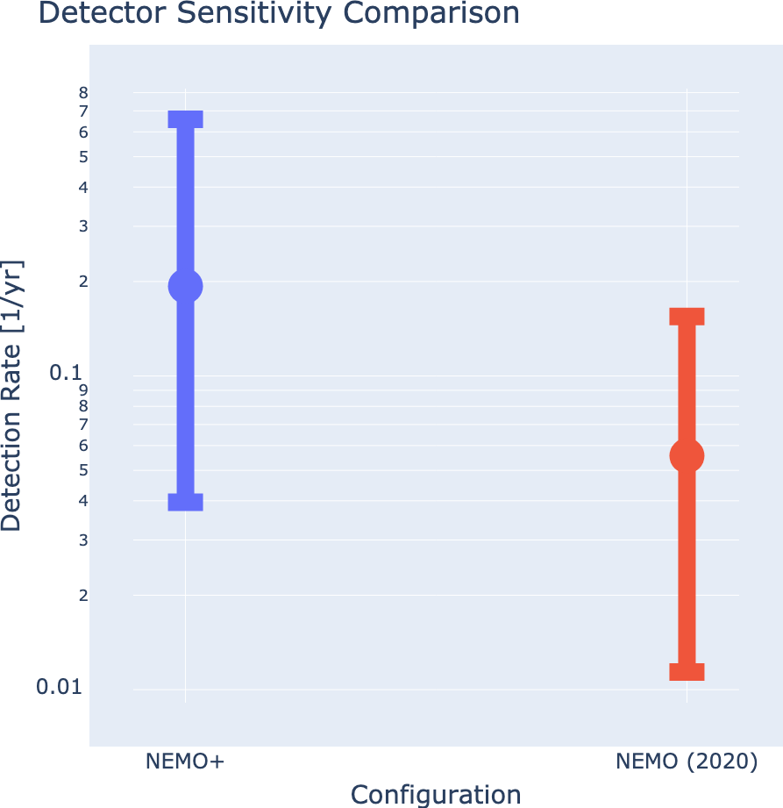
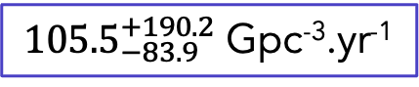
Optimising NEMO
Model detector configurations
Inject NR waveforms
Calculate detection rate
Aim Maximise BNS post-merger signal detection rate
Results
Optimal detection rate: 0.03 - 0.44 yr⁻¹ (c.f. 0.006 - 0.08 yr⁻¹) (single detector)
Uncertainty from merger rate
NEMO in network: ~10⁰ yr⁻¹
More observation runs needed
${105.5}_{−83.9}^{+190.2}$ Gpc⁻³.yr⁻¹
Abbott, BP et al. , ‘Population of merging compact binaries inferred using gravitational waves through GWTC-3’, Physical Review X (accepted December 2022)

Slide 22
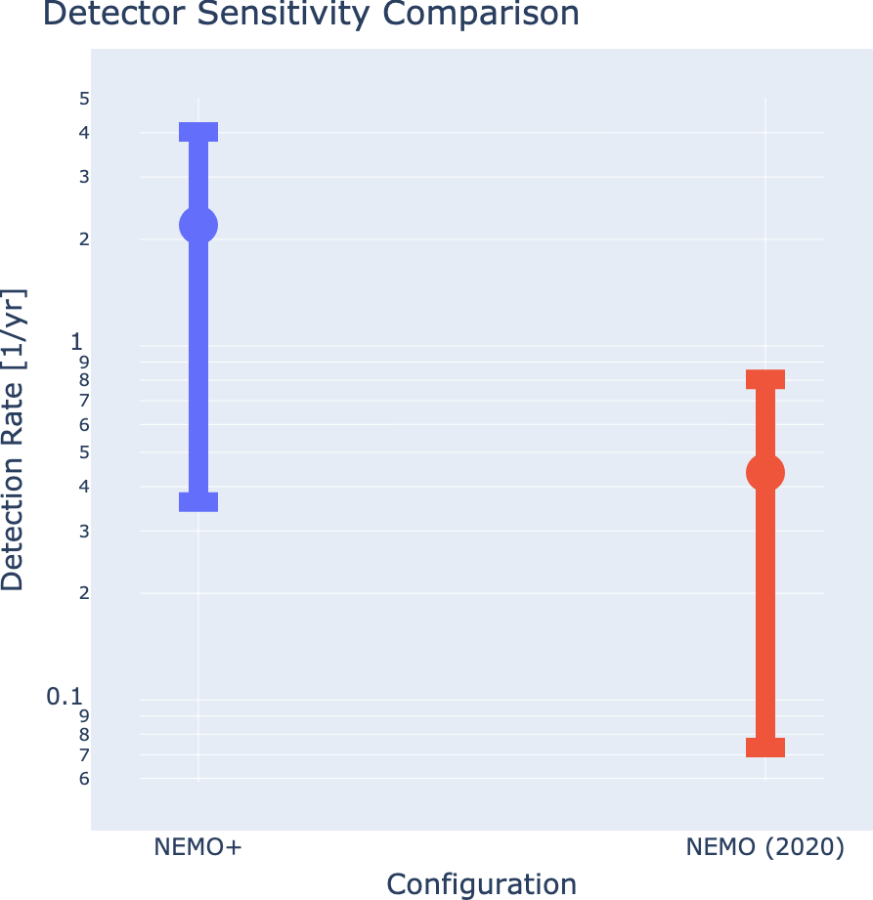
Optimising NEMO
Model detector configurations
Inject NR waveforms
Calculate detection rate
Aim Maximise BNS post-merger signal detection rate
Results
Optimal detection rate: 0.36 - 4.02 yr⁻¹ (c.f. 0.07 - 0.80 yr⁻¹) (single detector)
Uncertainty from merger rate
NEMO in network: ~10⁰ yr⁻¹
More observation runs needed
Rate in NEMO paper
250-2810 Gpc⁻³.yr⁻¹
Abbott, BP et al. 2020, 'GW190425: Observation of a Compact Binary Coalescence with Total Mass ∼ 3.4 M⊙
’, The Astrophysical Journal Letters, vol. 892, no. 1

Slide 23

Summary
Further work
Homodyne readout
Other sources of noise
Nonlinear optics
Detection rate in network
Supercomputer run
Matched-filter SNR
Alternative cost functions
Meta-optimisation
Investigate astrophysical assumptions
Optimising distinguishability of EoS
University of Warwick/Mark Garlick, CC BY 4.0 <https://creativecommons.org/licenses/by/4.0>, via Wikimedia Commons

